Slide 1



Predicting Tissue-Specific Gene Expression from Blood Using AI
Presented by
Kartika Waluyo, 1000555
Vrinda Rajendar Rajanahally, 1129446
Supervised by
Roberto Bonelli PhD, CSL Research
Brendan Ansell PhD, WEHI
Milica Ng
Prof Melanie Bahlo, WEHI
Monther Alhamdoosh PhD, CSL Research
Ziad Al Bkhetan PhD, The University of Melbourne
Prof Michael Kirley, The University of Melbourne
25 June 2021

Slide 2
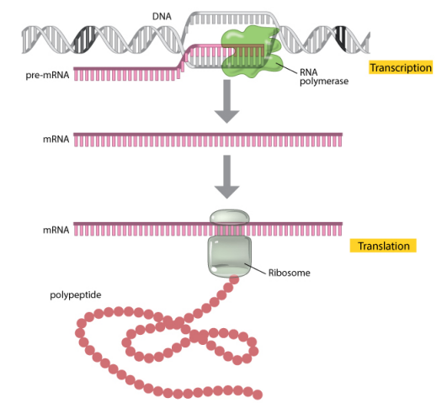
Introduction
Gene expression
Measured through RNA sequencing
Indicates the “activation level” of genes in a tissue
Used to understand disease mechanisms and assess the effectiveness and safety of treatments
protein
Image source: https://www.nature.com/

Slide 3

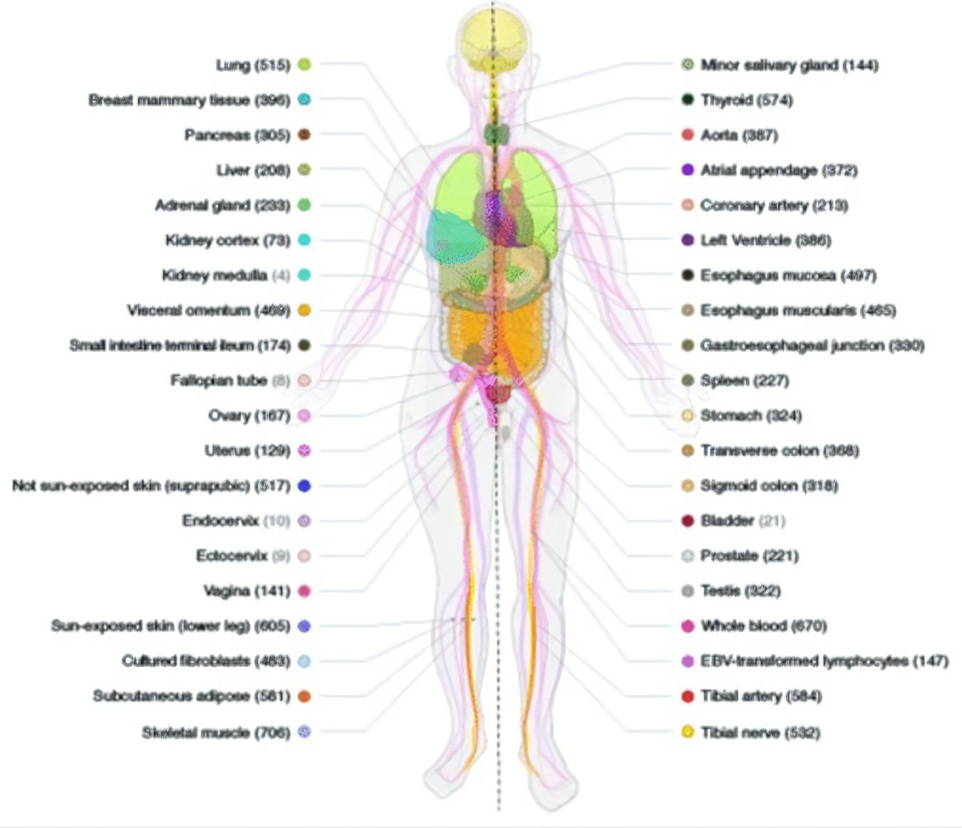
Data
The Genotype-Tissue Expression (GTEx)
Publicly available dataset containing gene expression of 54 post-mortem tissues from almost 1,000 individuals
Website: https://www.gtexportal.org/home/
Image source: https://www.researchgate.net/figure/Sample-and-data-types-in-the-GTEx-v8-study-A-Illustration-of-the-54-tissue-types_fig1_336246636
Notes:
The Genotype-Tissue Expression (GTEx) project is an ongoing effort to build a comprehensive public resource to study tissue-specific gene expression and regulation. Samples were collected from 54 non-diseased tissue sites across nearly 1000 individuals,

Slide 4
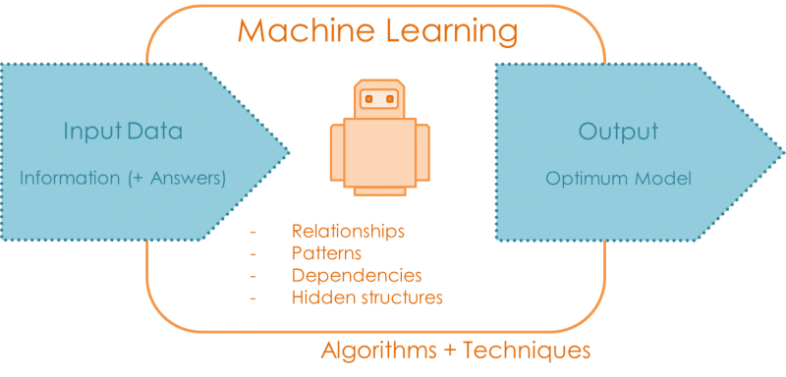
Problem
Gene expression varies across tissues
Obtaining samples from heart, lung, brain and other organs is often not possible
Goal
Whole blood gene expression
Al
(+Tissue X gene expression)
Algorithms + techniques
Image source: https://quantdare.com/
Notes:
The main problem that we are facing is that we need to assess new treatments corresponding to certain tissues, and to do so, we need to understand the gene expression of said tissues. However, obtaining samples from heart, lung, brain and other organs is often not possible without invasive procedure.
Therefore, the goal of this project is to develop a machine learning algorithm that can reliably predict gene expression in many different tissues when only gene expression measurements in whole blood are available.
Here the input data will be the gene expression from whole blood as well as from the other tissue that we wish to predict. Then the algorithm will learn about their relationships, patterns, dependencies, and hidden structures, and then it will give us an optimum model that we can use to do further prediction.

Slide 5


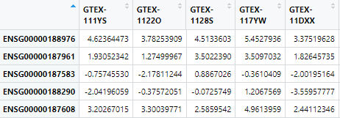
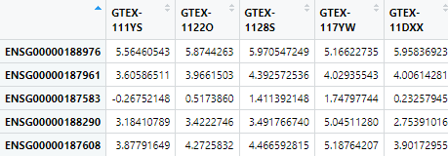

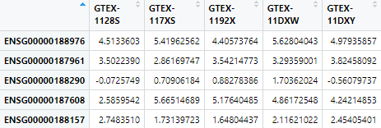
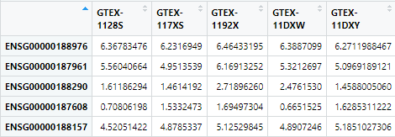
Data Preprocessing
Notes:
To simplify the problem, for each tissue, we only keep the shared genes and shared donors with blood
Here’s a snapshot of how the data looks like. The columns are the donors and the rows are the genes.
Later on, the data will be transposed so the columns will be the genes and the rows will be the donors because in this context, the genes will be the explanatory variables and each donor will be treated as 1 individual sample

Slide 6
Preliminary Data Analysis
Exploration of similarities between each tissue and whole blood
Shared expressed genes
Shared donors
Gene expression correlation

Slide 7
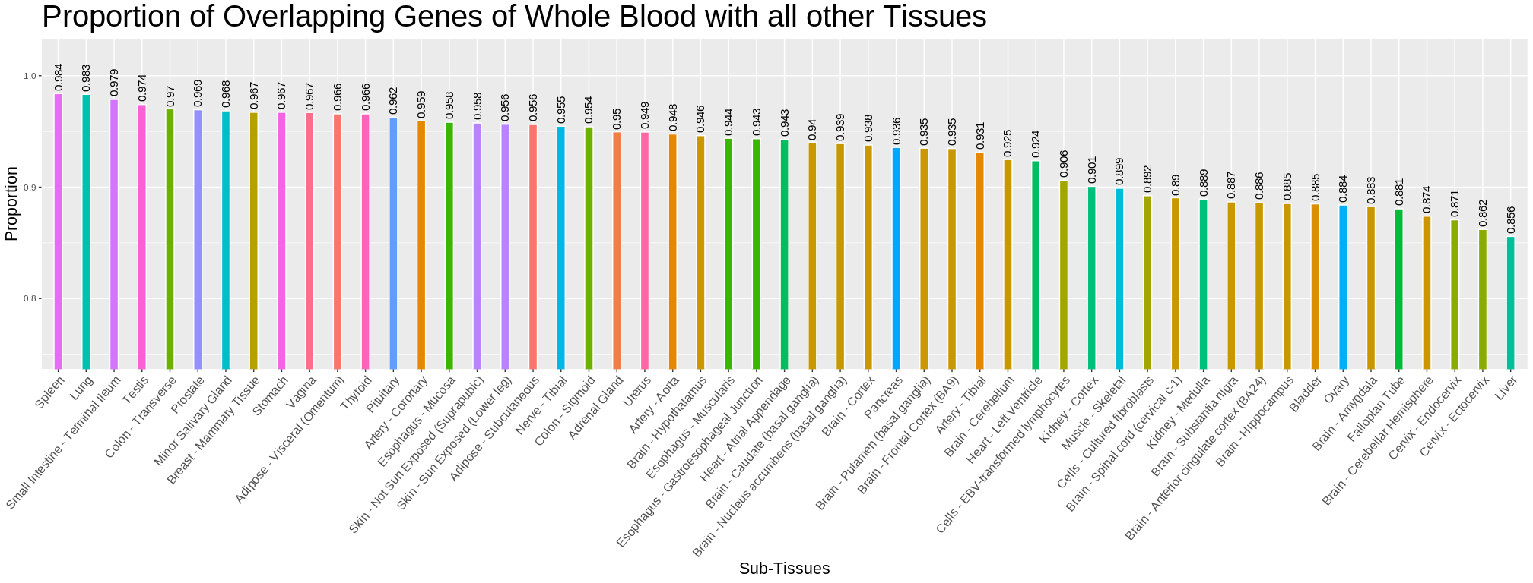
Notes:
The figure shows the proportion of shared genes of Whole Blood with all other tissues. The Spleen, Lung, and Terminal Illeum have the highest proportion of shared genes which are also found in Whole Blood. The proportion of shared genes in Liver and Whole Blood is the least amongst the lot.

Slide 8
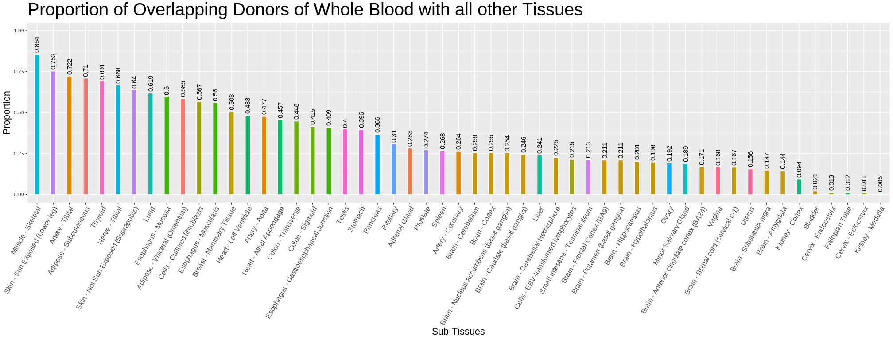
Notes:
The figure depicts the proportion of overlapping donors of Whole Blood in all other Tissues. Muscle – Skeletal, skin – sun exposed, and artery - tibial have the highest proportion of overlapping donors with Whole Blood whereas, Kidney - Medulla has the least. It gives us a picture of how many Whole Blood donors have also donated other tissues.

Slide 9
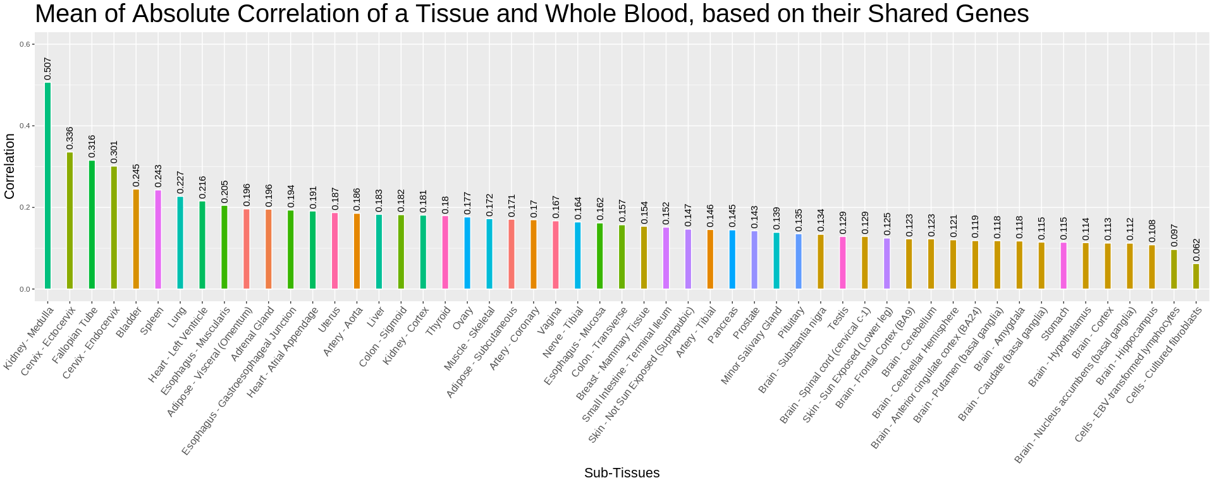
Pairwise correlation between each gene in whole blood's gene expressions with the same gene in other tissues' gene expressions.
Notes:
The figure represents the mean of absolute correlation between a tissue and Whole Blood, based on their shared genes.
The absolute correlation is a measure that denotes the strength of the relationship between the tissue and Whole Blood, based on their shared genes, regardless of the direction. Here, kidney – medulla, cervix – ectocervix, and fallopian tube have the strongest relationship with whole blood

Slide 10
Tissue Selection
Rank tissued based on the previously observed measures
Notes:
Finally, to acquire selection of the best tissues across all measures, we rank tissues based on three different measures: proportion of overlapping donors, proportion of shared genes and correlation between expression levels. The rank per tissue per measure is averaged out to give us the final rank it holds.
Taking the best case, from here we’ll only work with lung for trial purposes

Slide 11

Cross-validation
80%
Test data
20%
374 samples
93 samples
93 samples
Finding Parameters
Test data
Image source: https://scikit-learn.org/stable/modules/cross_validation.html
Notes:
To assess the performance of the models we need a test set which is the unseen set, and a training set which will be used to train the model. For model selection we need a validation set, and in order to achieve randomness and unbiased result we did a cross validation.
Split the data into training and test set 80:20
Split the training data into 5 folds
Train the models using training data
For hyperparameter tuning , do 5-fold CV
Take the average evaluation measure from 5 iterations
Choose the best hyperparameter combination
Train all the training set using the best hyperparameter value
Test using test set
For long presentation
Maybe explain about: 1st iteration use Fold1 as test set and Fold2-5 as training set, 2nd iteration use Fold2 as test set and Fold1,3-5 as training set, and so on

Slide 12
Models
eXtreme Gradient Boosting
Neural Network
Ensemble Model

Slide 13
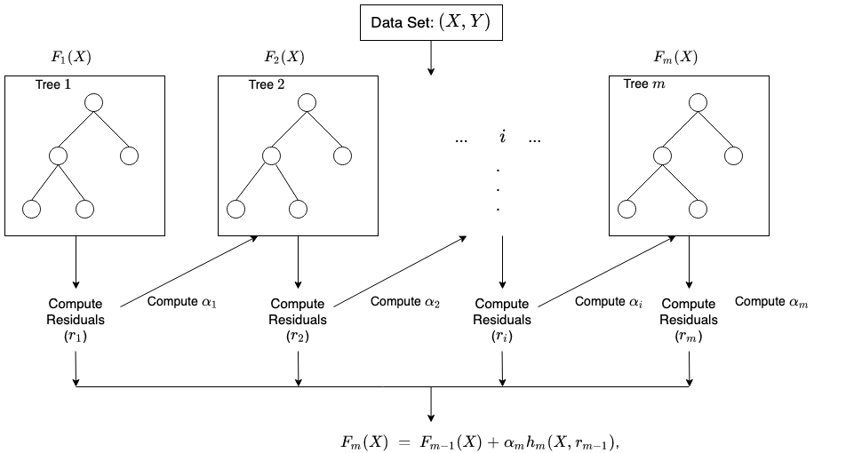
eXtreme Gradient Boosting (XGBoost)
Maximum Depth
Gamma: minimum loss reduction required to make a further partition on a leaf node of the tree.
m = number of rounds
m = number of rounds: number of trees
Eta: learning rate
Image source: https://docs.aws.amazon.com/sagemaker/latest/dg/xgboost-HowItWorks.html
Notes:
Boosting is an ensemble technique where new models are added to correct the errors made by existing models. Models are added sequentially until no further improvements can be made. The trees are built sequentially such that each subsequent tree aims to reduce the errors of the previous tree. Each tree learns from its predecessors and updates the residual errors. Hence, the tree that grows next in the sequence will learn from an updated version of the residuals.
It's called gradient boosting because it uses a gradient descent algorithm to minimize the loss when adding new models.
Here, we create 1 model for 1 gene bcs the model doesn’t accept multivariate output
So the input is the whole gene matrix from blood
And the output is 1 gene from lung

Slide 14
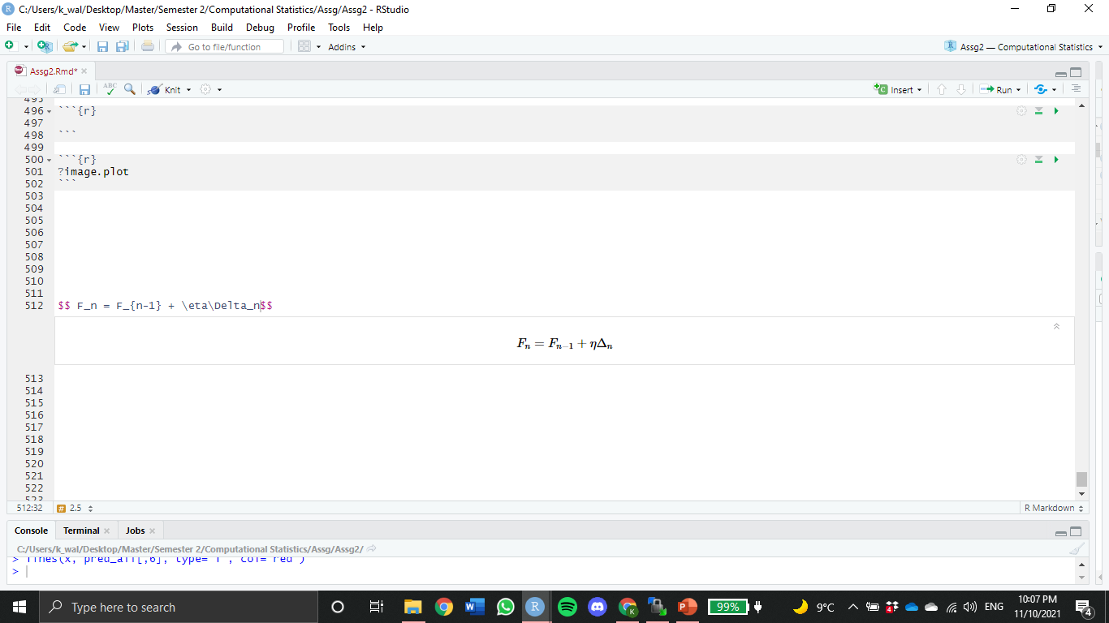
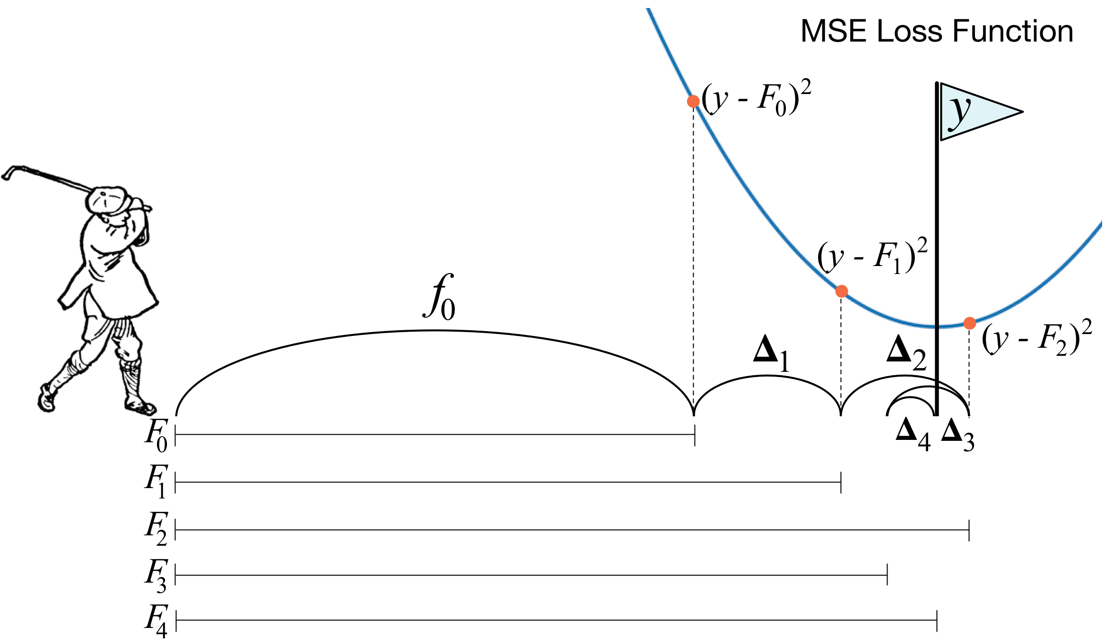
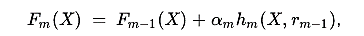
Gradient Boosting Machines (GBM)
Gradient Boosting approach is given by
Recall from previous slide
eta
residual
Image source: https://explained.ai/gradient-boosting/descent.html
Notes:
Gradient Boosting Machines (GBM)
Consider η=1, at each stage, GBM predicts the y - Fₙ₋₁ (residual or gradient of loss) which is difference of distance from pole to the golf ball
So, at every iteration, GBM tries to predict this distance, which is like golfer aiming for pole before each shot. And sometimes the ball can even cross the pole (like Δ₂), hence using the gradient descent, correct sign is applied when Δ is calculated.
So its recommended to use smaller η, such that the minima of loss or the pole isn’t missed.

Slide 15
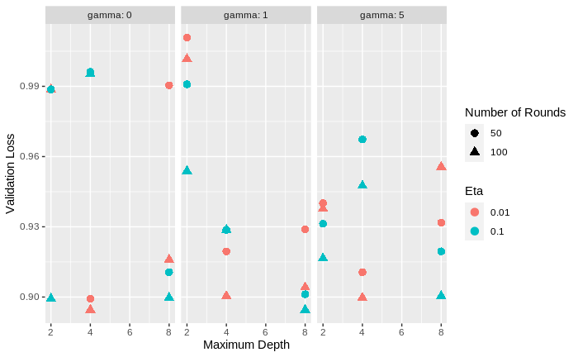
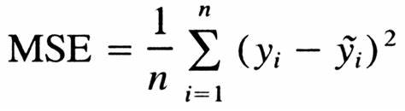
Hyperparameter Tuning
On 50 random genes
On gamma, maximum depth, eta, and number of rounds
Loss Function
Best hyperparameter combination: gamma=1, maximum depth=8, eta=0.1, and number of rounds=100
Notes:
We did a gridsearch to find the best hyperparameter combination using MSE as the loss function.
Hyperparameters being considered are:
gamma=[0,1,5]
maximum depth=[2,4,6,8]
eta (learning rate)=[0.01, 0.1]
number of rounds(number of trees)=[50,100]
Go back to previous slide to explain about the hyperparameters (in green)
Because the gridsearch took a very long time to run we only ran it using 50 random genes.
With 50 random genes it took approximately 10 hours.
After the best performance parameter were chosen, the model was trained again on all genes
For long presentation
Loss Function: The role of the loss function is to estimate how best is the model in making predictions with the given data.

Slide 16
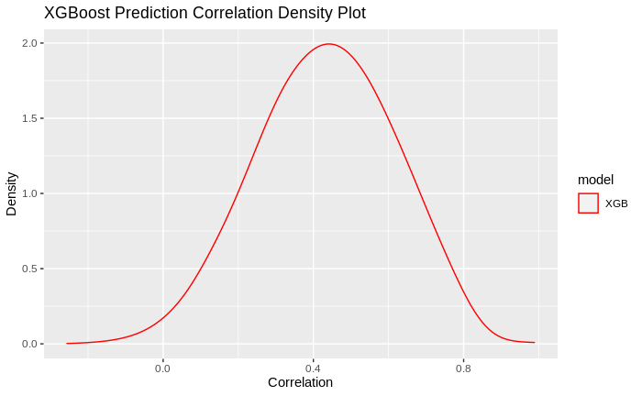
Evaluation
Compute the correlation between each gene in the prediction and its true value
Model | Median Correlation
Model | Training | Test
XGBoost | 0.990975 | 0.4364047
Neural Network
Ensemble
Notes:
We compute the correlation between each gene in the prediction and its true value
For training prediction, the median correlation is 0.99
And for test prediction, the median correlation is 0.43
The plot shows high density for positive correlation which means that high number of genes in lung have strong relationship with genes in whole blood

Slide 17
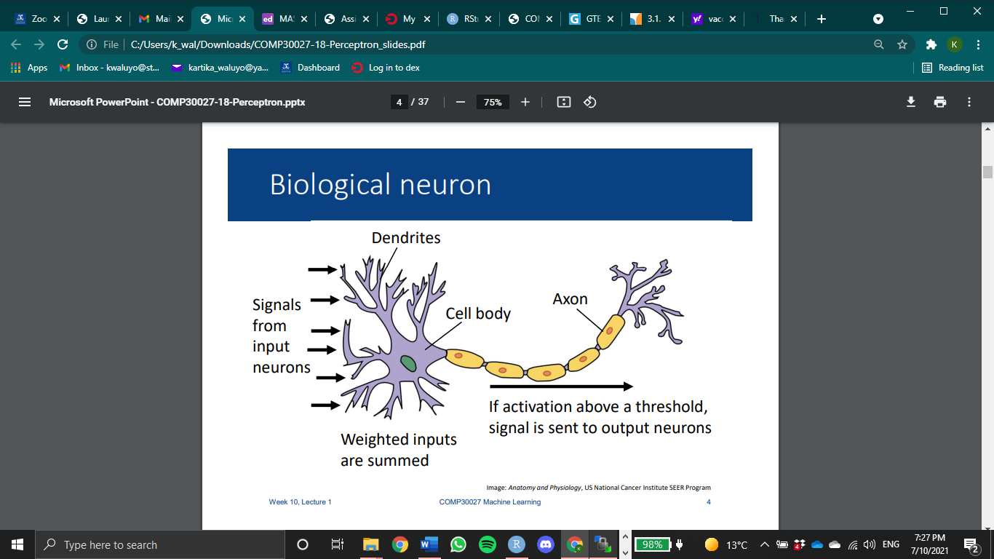
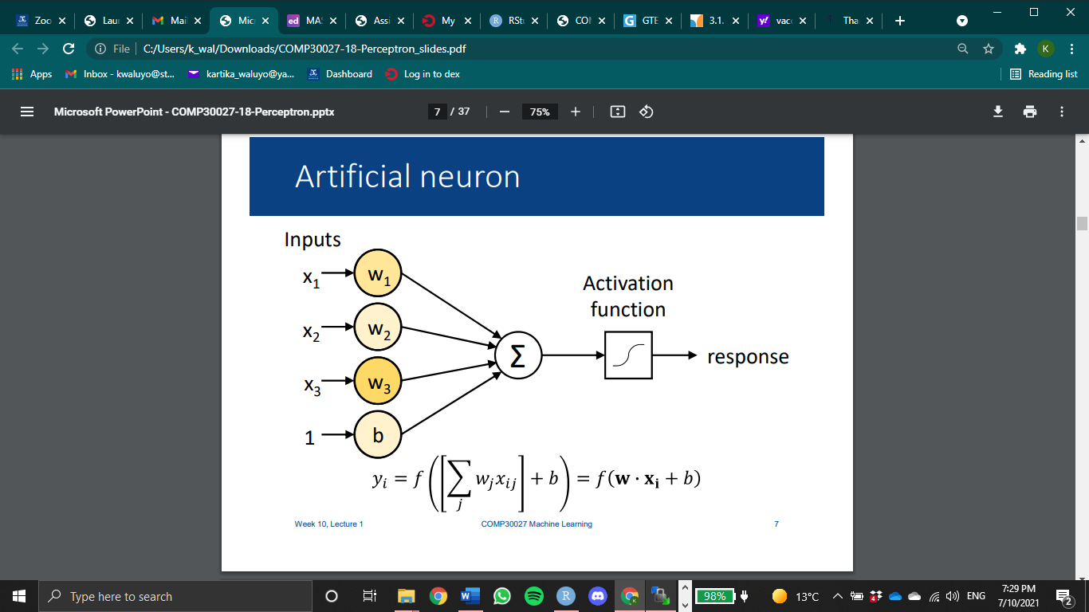
Neural Network
Biological Neuron
Artificial Neuron
Image Source: Anatomy and Physiology, US National Cancer Institute SEER Program
Image Source: The University of Melbourne COMP30027 Machine Learning Lecture, by Kris Ehinger
Notes:
The next model we built is NN
Training a NN entails finding the weights which minimize errors on the training data
We train a NN by iterating over examples in a training dataset
Input is the whole blood gene expression
Response is the lung gene expression
Activation function: relu for the hidden layers and linear for the output layer
For long presentation:
Each iteration over the whole dataset is called an epoch

Slide 18
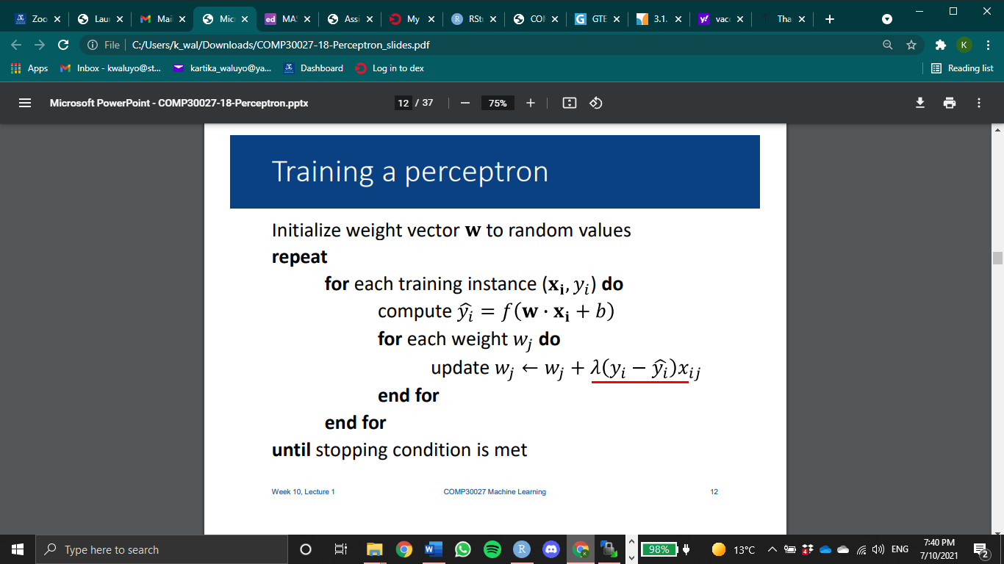
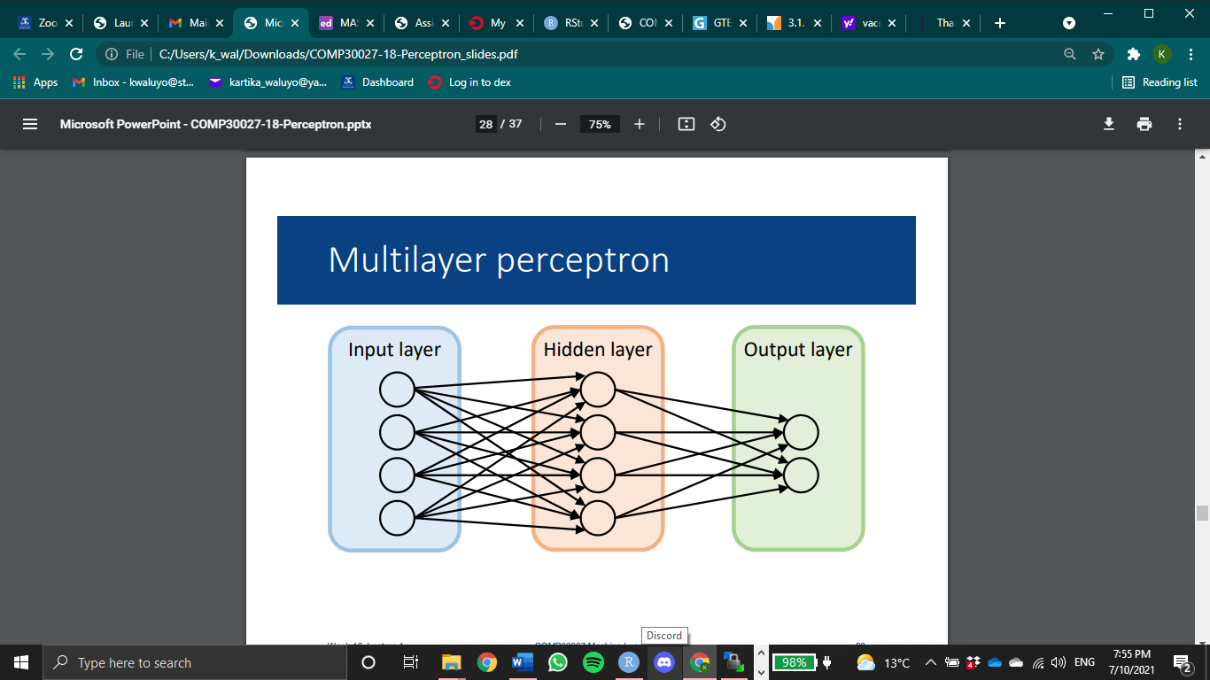
Algorithm
1 epoch
Backpropagation/gradient descent
Learning rate
High → big jump on the update
Image Source: The University of Melbourne COMP30027 Machine Learning Lecture, by Kris Ehinger
Notes:
Algorithm:
• For training examples, compute y based on current weights
• Update weights based on the difference between predicted y and true label
However,
Need to find correct weights for the output neuron(s), and all the neurons in the hidden layer
Can’t use the algorithm in the hidden layer – we don’t know what values these neurons are supposed to produce for the input
• There is no one set of “correct” values for this layer – multiple possible solutions
• Solution: backpropagation
Backpropagation:
• Form of gradient descent – iterative process for finding the weight parameters that minimize error
• Requires a learning rate → how fast we want our algo to converge
• Idea: look at the derivative of error and update weights in the direction that would reduce error
• Compute errors at the output layer w.r.t. each weight using partial differentiation
• Propagate errors back to each of the earlier layers

Slide 19
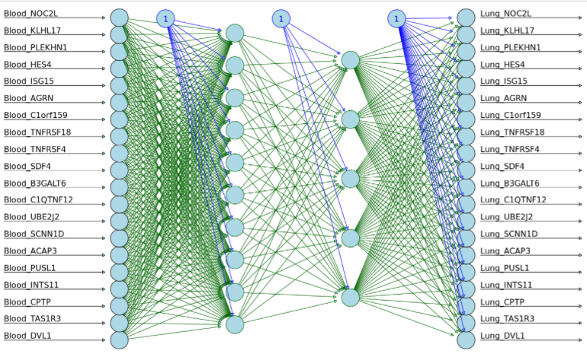
Illustration of how our neural network model might look
Input
1st hidden layer
2nd hidden layer
Output

Slide 20
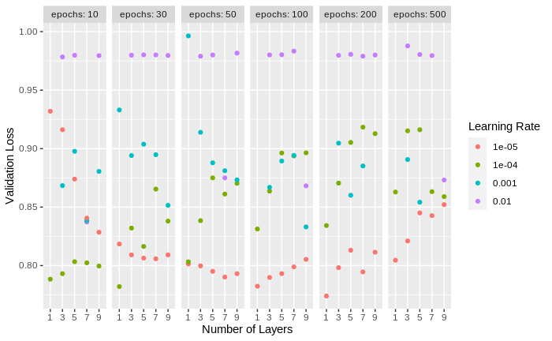
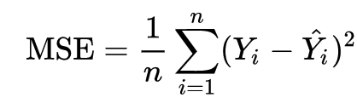
Hyperparameter Tuning
On number of layers, learning rate, and number of epochs
Loss Function
Best parameter combination:
1 hidden layer of 100 units, e⁻⁵ learning rate, and 200 epochs
Notes:
Similar to what we did with xgboost we did a gridsearch
On number of layers, learning rate, and number of epochs
Here we can observe that when learning rate is 0.00001, there’s a clear pattern happening (pink).
For low epoch, 10, 30 and 50, the loss decrease as the number of layers increase. However when epoch is 100, 200 and 500 the loss increase along with the number of layers. This makes sense because a quick training or low epoch training needs deeper and wider model to fit more nicely. However, when it’s a high epoch training, if we train a deep or wide model it will overfit.

Slide 21
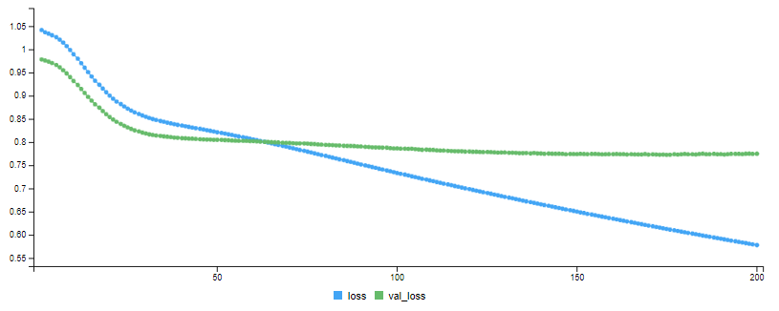
Result
Train and validation MSE, using the best model
MSE
Validation MSE

Slide 22
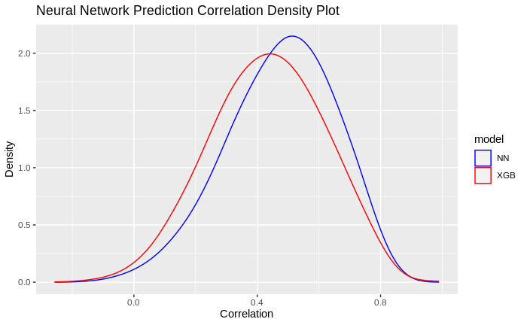
Evaluation
Compute the correlation for each gene in the prediction and the true value
Model | Median Correlation
Model | Training | Test
XGBoost | 0.990975 | 0.4364047
Neural Network | 0.6278658 | 0.4887672
Ensemble
Notes:
For training prediction, the median correlation is 0.63
And for test prediction, the median correlation is 0.489
Here we can observe that although the training correlation for NN is much lower than xgboost, but the test correlation is higher
This might happen because the xgboost model overfits

Slide 23
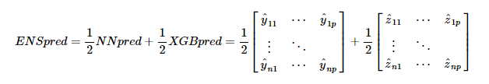
Ensemble Prediction
Notes:
Next, we create the most simplistic version of the ensemble prediction. We take the average of the NN and XGB prediction

Slide 24
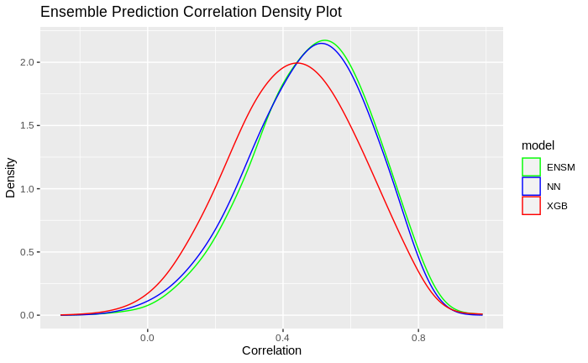
Evaluation
Compute the correlation for each gene in the prediction and the true value
Model | Median Correlation
Model | Training | Test
XGBoost | 0.990975 | 0.4364047
Neural Network | 0.6278658 | 0.4887672
Ensemble | 0.9205496 | 0.4976427
Notes:
For training prediction, the median correlation is 0.92
And for test prediction, the median correlation is 0.498
Here we can see that the ensemble prediction’s correlation is higher than both NN and XGB.
This can be a basis for a more advanced ensemble model in the future
Another model can be trained

Slide 25
Future Directions
Training the models on all other tissues, on the entire dataset
Stacking ensemble for improved prediction
Biological validation
Implementation of the web application

Slide 26

We would like to extend a heartfelt thank you to all our mentors involved in this project!
Roberto Bonelli PhD, CSL Research
Brendan Ansell PhD, WEHI
Milica Ng
Prof Melanie Bahlo, WEHI
Monther Alhamdoosh PhD, CSL Research
Ziad Al Bkhetan PhD, The University of Melbourne
Prof Michael Kirley, The University of Melbourne

Slide 27
Questions?

Slide 28
Thank You

